Slide 1







Master Topology
13th Jan 2020

Slide 2
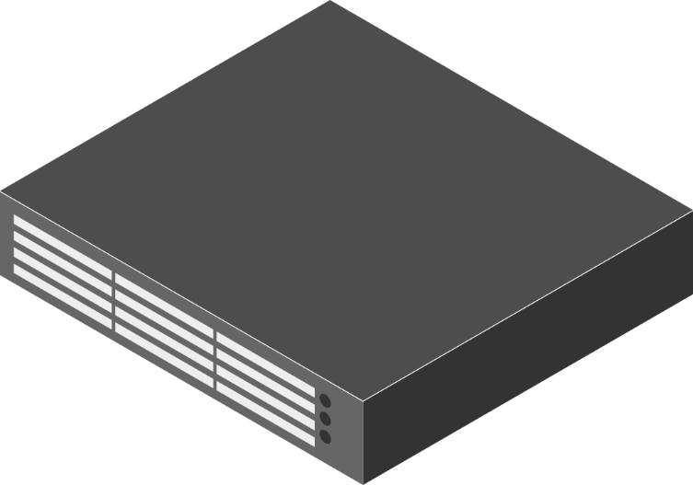


Master Topology
Spirent – 5/12
Spirent – 12/2
Spirent – 12/1
Spirent – 5/9
.161 com1
(EMX)
.162 com1
(EMX)
15
DELTA_AX
48 com1
17
12
.47 com2
(EMX)
3
11
14
14
Alpha UX
195 com4
16
16
13
15
12
13
11
16
15
17
3
11
16
13
.47 com1
(EAX)
0.162 com2
(EMX)
17
7
6
10
14
8
02
3
11
14
3
3
11
7,12
01
5
10
18
12
9
7,12
19
15,2
11,2
11
Delta UX
195com2
UFI AX
162 com3
13
10
UFI AX
161 com3
13
11
9
xl 0/1,0/2
18
23
18
13
xl 0/1, 0/2
13
Delta UX
195com1
15
.47 com3
(EAX)
Spirent – 5/10
Spirent – 5/3
Spirent – 12/4
Spirent – 5/11
Spirent – 5/4
Spirent – 5/2
Spirent – 12/3

Slide 3
Proposed Topology Changes
Alpha
195 com4
Spirent – 5/12
Spirent – 12/2
Spirent – 12/1
Spirent – 5/9
.161 com1
(EMX1)
.162 com1
(EMX4)
15
DELTA_AX
48 com1
17
12
.47 com2
(EMX2)
3
11
14
14
Edgecore AX
195 com3
16
16
13
15
12
13
11
16
16
13
15
17
3
11
.47 com1
(EAX1)
0.162 com2
(EMX3)
10
17
7
6
14
8
02
3
11
14
3
3
11
7,12
01
5
10
18
12
9
7,12
19
15,2
11,2
11
Delta
195com2
162 com3
13
10
161 com3
13
11
9
xl 0/1,0/2
18
23
18
13
xl 0/1, 0/2
13
Delta
195com1
15
.47 com3
(EAX2)
7315
Spirent – 5/10
Spirent – 5/3
Spirent – 12/4
Spirent – 5/11
Spirent – 5/4
Spirent – 5/2
Spirent – 12/3

Slide 4
Updated Topology Changes – Current Topology 22-Apr
Alpha
195 com3
Spirent – 5/12
Spirent – 12/2
Spirent – 12/1
Spirent – 5/9
15
16
.161 com1
(EMX1)
.162 com1
(EMX4)
15
DELTA_AX
48 com1
15
12
.47 com2
(EMX2)
3
11
14
14
EdgecoreAX 47 com3
16
16
13
15
12
13
11
12
16
10
17
3
11
.47 com1
(EAX1)
0.162 com2
(EMX3)
10
17
7
6
8
02
3
11
14
3
3
11
09
5
10
12
9
09
19
15,2
11,2
Delta
195com2
162 com3
13
10
161 com3
13
11
9
23
18
13
13
Delta
195com1
Spirent – 5/10
Spirent – 5/3
Spirent – 12/4
Spirent – 5/11
Spirent – 5/4
Spirent – 12/3

Slide 5
Updated Topolgy changes- April 23rd
Alpha 195 com3
Spirent – 5/12
Spirent – 12/2
15
Spirent – 12/1
Spirent – 5/9
16
DELTA_AX
48 com1
15
.161 com1
(EMX1)
.47 com2
(EMX2)
48com2
(EMX4)
15
12
3
11
14
14
Edgecore AX
47 com3
16
16
13
15
12
13
11
12
16
10
17
3
11
.47 com1
(EAX1)
0.162 com2
(EMX3)
10
17
7
6
4
8
02
3
11
14
3
3
11
09
09
5
10
23
12
9
13
19
15,2
11,2
12
Delta
195com2
13
162 com3
15
10
161 com3
13
9
7
02
23
18
11
13
15
13
Delta
195com1
14
15
.162 com1
7315 NOS
Spirent – 5/10
Spirent – 5/3
Spirent – 12/4
Spirent – 5/11
Spirent – 5/4
Spirent – 5/2
Spirent – 12/3

Slide 6
Changes to be done
Spirent – 5/12
Spirent – 12/5
Spirent – 12/7
Spirent – 12/2
Spirent – 12/1
Spirent – 5/9
16
.161 com1
(EMX1)
3
.47 com2
(EMX2)
15
DELTA_AX
48 com1
12
15
162 com5
18-smt
16
161 com4
5835
15
14
11
14
Edgecore AX
47 com3
12
13
11
11
12
17
161 com5
5916
16
10
3
5
.47 com1
(EAX1)
11
3
0.162 com2
(EMX3)
17
6
10
8
14
2
4
162com1
848
3
3
11
02
5
10
12
9
19
15,2
11,2
10
23
Delta
195com2
13
162 com3
15
161 com3
13
11
9
1
18
13
15
1
13
Delta
195com1
79 com1
7648
Spirent – 5/10
Spirent – 5/11
Spirent – 5/3
Spirent – 5/4
Spirent – 12/4
Spirent – 5/2
Spirent – 12/3

Slide 7
Regression Setup Details
Board Type | Target | PC Detail | Port Type | Remarks
EAX -AS7316-26X | 172.30.0.47 (Com1) | 172.30.0.47 | 6 * 10G cables | PBB delivery validations and edgecore delivery validations. Will be used in PlugFest topology
EMX-AS5912-54X | 172.30.0.162 (Com1) | 172.30.0.162 | 6 * 10G cables
UFI AX – S9500-30XS | 172.30.0.161 (Com3) | 172.30.0.161 | 6 * 10G cables | SIAE release done and planned
Delta UX AGC7008S | 172.30.0.195 (Com1) | 172.30.0.195 | 4 * 1G cables | Port bringup issues for 4 ports in Target. Target used for PlugFest, PTP and OTN planned releases
Delta AX AGCV208S | 172.30.0.48 (com1) | 172.30.0.48 | 6 *10G cables | PC issues. Setup not running properly. Target used for PlugFest, OTN planned releases
UfI UX - | 172.30.0.194 (com4) | 172.30.0.164 | 4 *1G cables | Setup in progress. 1 more NIC card not available. Being used by oneTos

Slide 8
Lab Setup – Target Details/Requirements

